Slide 1

Embedded Systems
C Programming
Session 1
GitHub

Slide 2


What’s a Version Control System?
A version control system, or VCS, tracks the history of changes as people and teams collaborate on projects together.
Teams can:
Fix bugs
Contribute on same project
Recover older versions of any code
Run Tests
Notes:
A version control system, or VCS, tracks the history of changes as people and teams collaborate on projects together. As the project evolves, teams can run tests, fix bugs, and contribute new code with the confidence that any version can be recovered at any time. Developers can review project history to find out:
Which changes were made?
Who made the changes?
When were the changes made?
Why were changes needed?

Slide 3
What’s a Version Control System?
Developers can review project history to find out:
Which changes were made?
Who made the changes?
When were the changes made?
Why were changes needed?

Slide 4
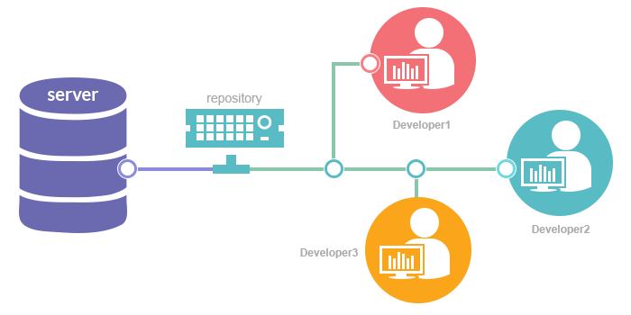
Version Control Systems

Slide 5
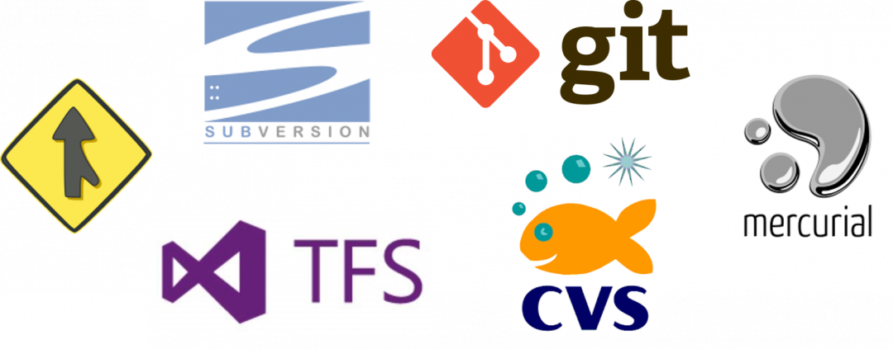
Version Control Systems

Slide 6
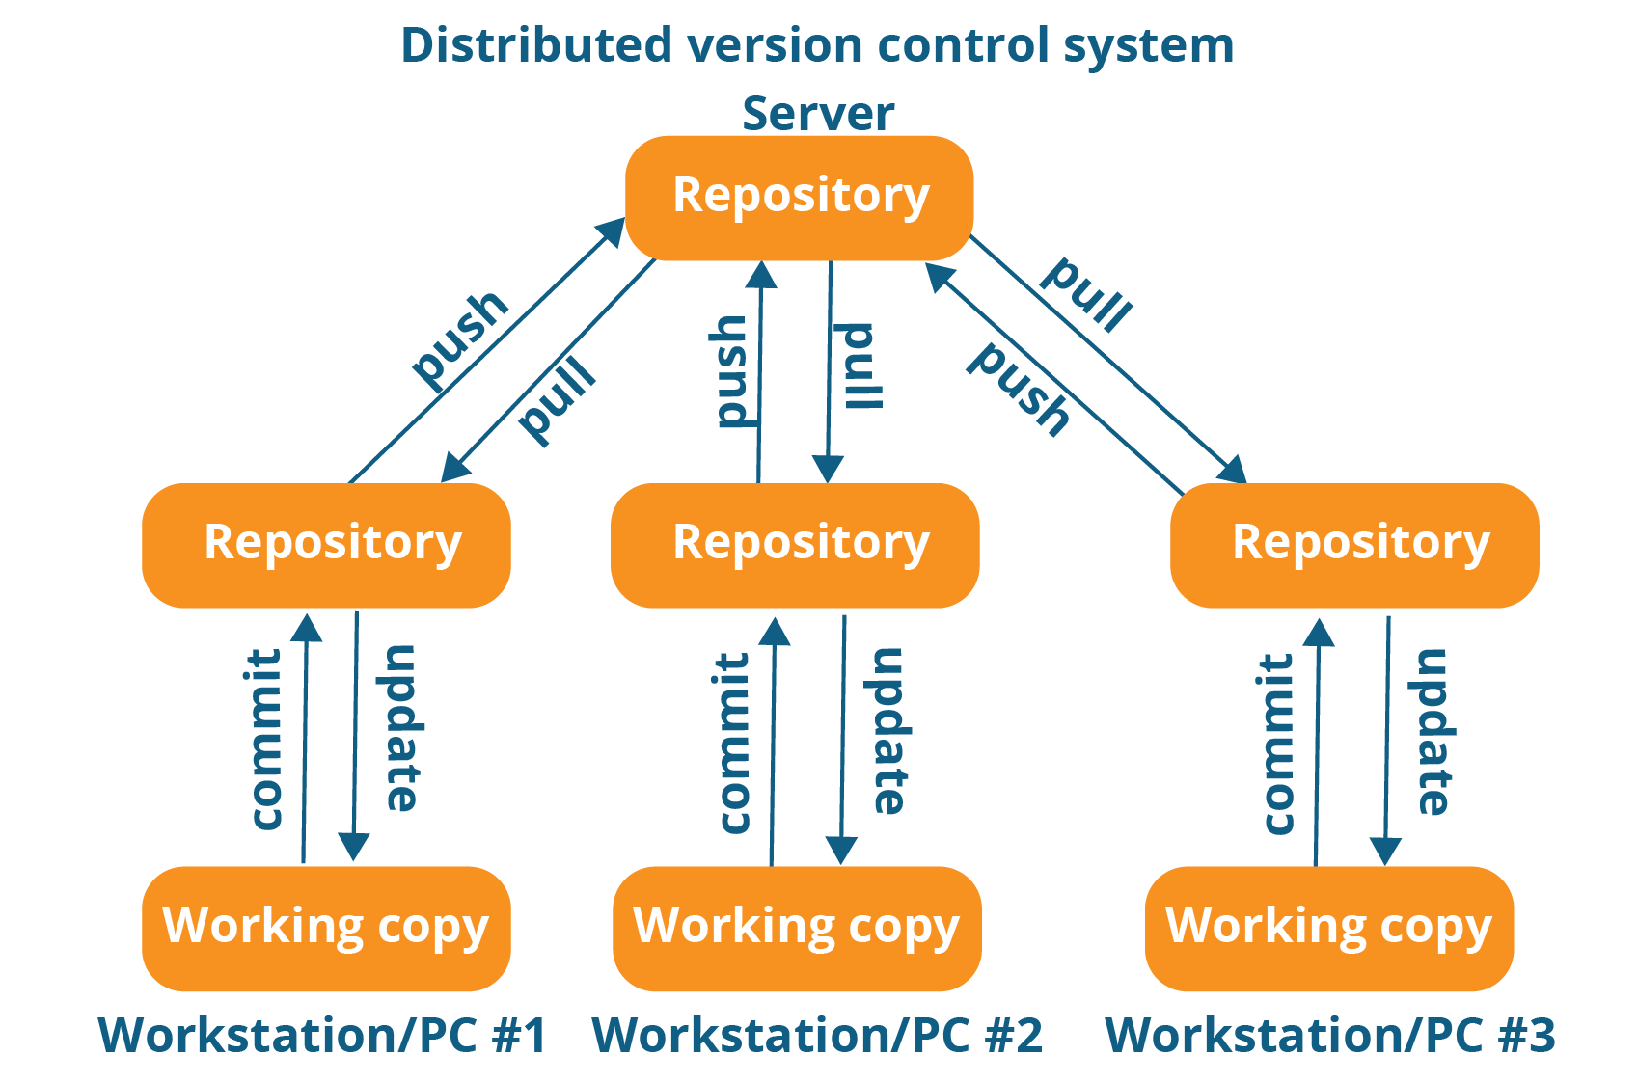

Distributed Version Control Systems

Slide 7

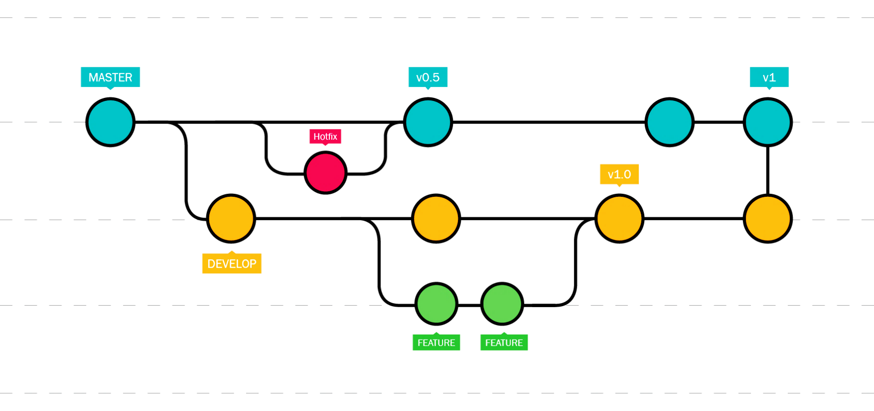
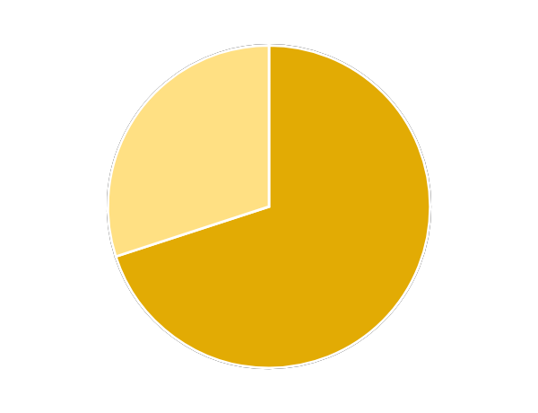
Why GIT?
According to the latest Stack Overflow developer survey:

Slide 8

How GitHub fits in

Slide 9
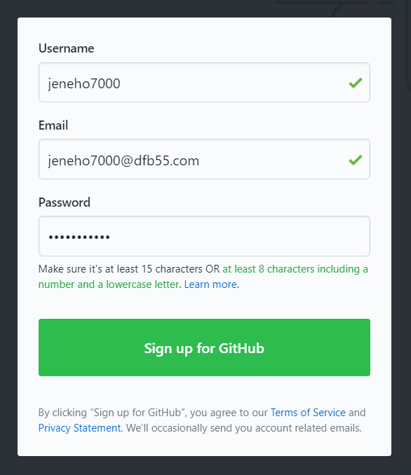
How to use GitHub?
Create a GitHub Account
1
Go to https://github.com/
Fill your information
Sign up for GitHub
Setup your preferences
Verify your E-mail
2
3
4
5

Slide 10

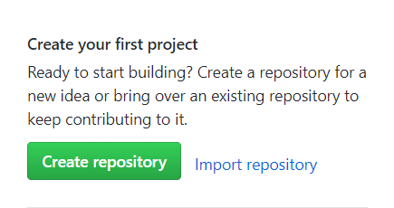
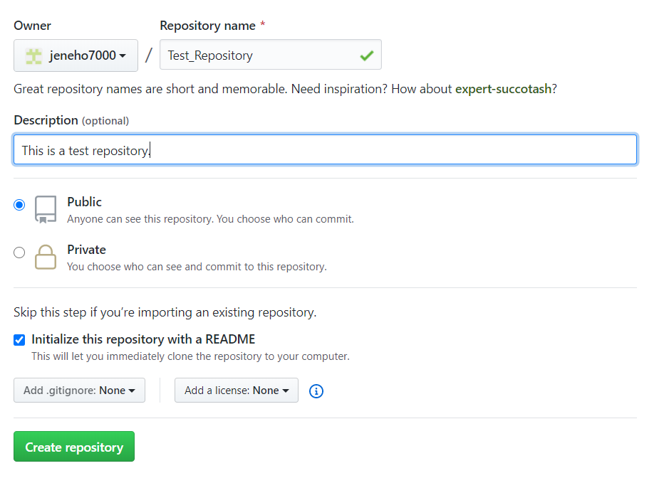
How to use GitHub?
Create your First Repository
1
Press on Create Repository
A repository, or Git project, encompasses the entire collection of files and folders associated with a project, along with each file’s revision history.
Enter Repository Name,
Enter a description, Choose Privacy, and Initialize README file.
Press on Create Repository
2
3

Slide 11
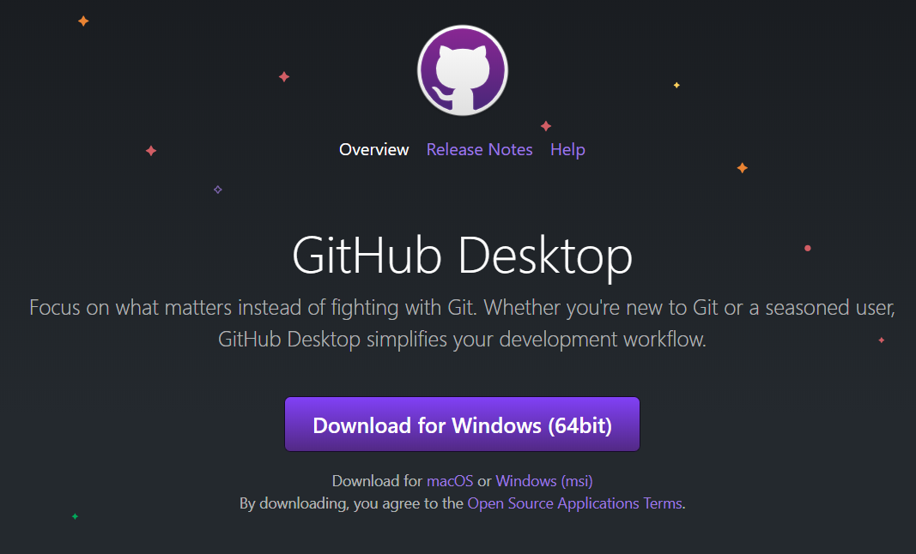
How to use GitHub?
Download GitHub Desktop
1
Go to https://desktop.github.com/
Download GitHub Desktop
GitHub Desktop eases the use of your repositories locally, where you can directly pull, commit, push, create branches and see log right from the program.
Install GitHub Desktop
Sign-In with your account
2
3
4

Slide 12
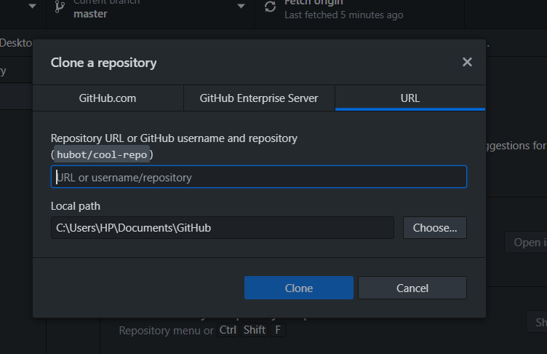
How to use GitHub?
Clone Your Repository
Cloning a repository creates a local copy on your computer so you can modify and update it using your preferred text editor or IDE.
1
On the taskbar go to
Files > Clone Repository
Enter Repository URL here
Choose Local path to save your clone
Press Clone
2
3
4

Slide 13
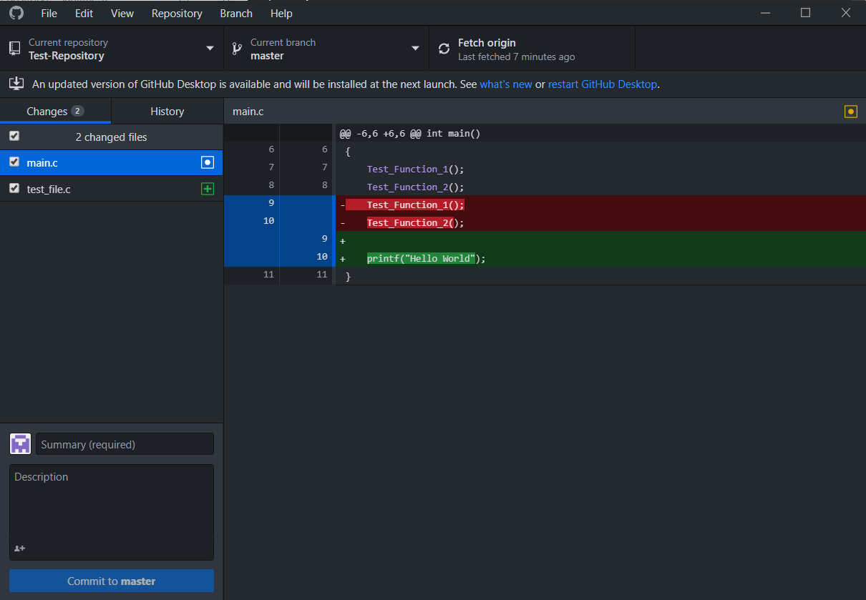
How to use GitHub?
Add and Edit Files Locally
1
Create your files
And Save them inside the repository on your computer.
Make all your updates
to any files in your repository.
All your Changes
will automatically appear on GitHub Desktop.
All Changes are done locally and not uploaded “pushed” to the GitHub Server online.
2
3

Slide 14
How to use GitHub?
Commit Changes to Repository
Committing a change does not upload the changes to the server. It only saves the snapshot to the project history and completes the change-tracking process.
Provide a Summary
of all the changes that were made. Add a more detailed Description if needed.
Press Commit to master
1
2

Slide 15
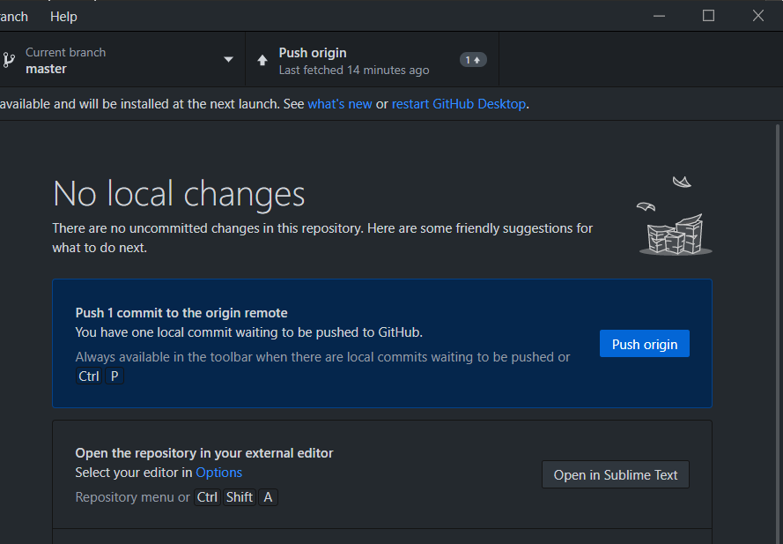
How to use GitHub?
Push local commits to GitHub
This will upload all your commits to the remote repository.
Press Push Origin
1

Slide 16
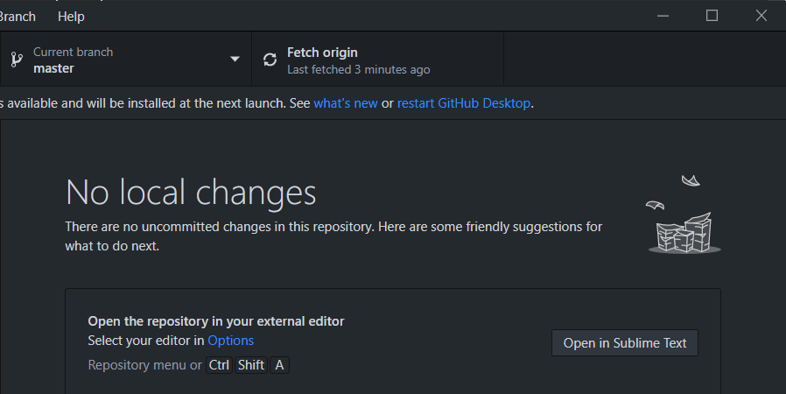
How to use GitHub?
Pull (Fetch) Repository
This will update your local repository from the server with all the changes made.
Press on Fetch Origin
1

Slide 17
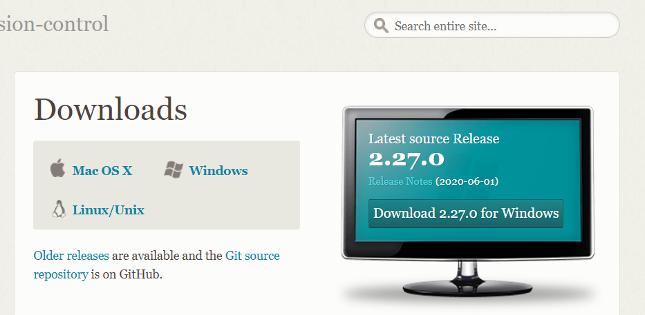
How to use GitHub?
Use Git on Command Prompt
Even though GitHub Desktop uses Git on your computer, it does not install Git to your Environment Variables.
Before you start using Git, you must make it available on your computer.
Go to https://git-scm.com/downloads
Download according to your OS
Install using your preferred settings
1
2
3

Slide 18
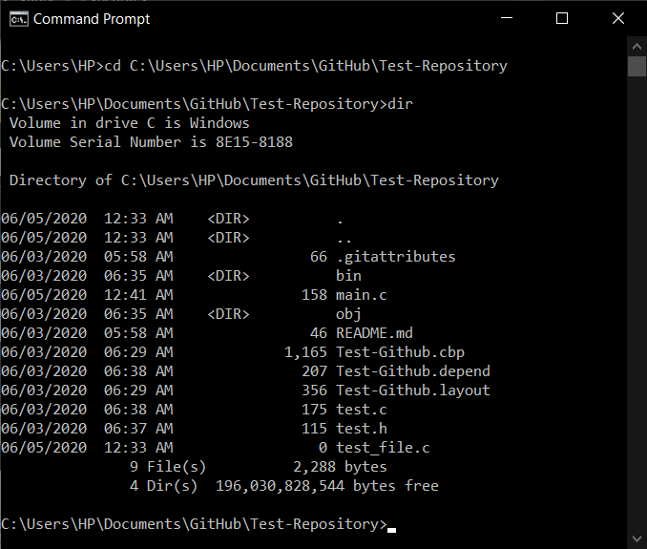
How to use GitHub?
Use Git on Command Prompt
1
Go to Repository Directory
In Command Line Window, use the command cd to go to the repository directory.
View directory content using dir
Now you can use all the Git Commands as long as you are inside a repository.
2

Slide 19
How to use GitHub?
Git Commands
1
git init
initializes a brand-new Git repository and begins tracking an existing directory.
creates a local copy of a project that already exists remotely. The clone includes all the project’s files, history, and branches.
shows the status of changes as untracked, modified, or staged.
2
git clone
3
git status
Notes:
git init initializes a brand-new Git repository and begins tracking an existing directory. It adds a hidden subfolder within the existing directory that houses the internal data structure required for version control.
git clone creates a local copy of a project that already exists remotely. The clone includes all the project’s files, history, and branches.
git add stages a change. Git tracks changes to a developer’s codebase, but it’s necessary to stage and take a snapshot of the changes to include them in the project’s history. This command performs staging, the first part of that two-step process. Any changes that are staged will become a part of the next snapshot and a part of the project’s history. Staging and committing separately gives developers complete control over the history of their project without changing how they code and work.
git commit saves the snapshot to the project history and completes the change-tracking process. In short, a commit functions like taking a photo. Anything that’s been staged with git add will become a part of the snapshot with git commit.
git status shows the status of changes as untracked, modified, or staged.
git branch shows the branches being worked on locally.
git merge merges lines of development together. This command is typically used to combine changes made on two distinct branches. For example, a developer would merge when they want to combine changes from a feature branch into the master branch for deployment.
git pull updates the local line of development with updates from its remote counterpart. Developers use this command if a teammate has made commits to a branch on a remote, and they would like to reflect those changes in their local environment.
git push updates the remote repository with any commits made locally to a branch.

Slide 20
How to use GitHub?
Git Commands
4
git add
stages a change.
saves the snapshot to the project history and completes the change-tracking process.
5
git commit
Git tracks changes to a developer’s codebase, but it’s necessary to stage and take a snapshot of the changes to include them in the project’s history. This command performs staging, the first part of that two-step process. Any changes that are staged will become a part of the next snapshot and a part of the project’s history. Staging and committing separately gives developers complete control over the history of their project without changing how they code and work.
Notes:
git init initializes a brand-new Git repository and begins tracking an existing directory. It adds a hidden subfolder within the existing directory that houses the internal data structure required for version control.
git clone creates a local copy of a project that already exists remotely. The clone includes all the project’s files, history, and branches.
git add stages a change. Git tracks changes to a developer’s codebase, but it’s necessary to stage and take a snapshot of the changes to include them in the project’s history. This command performs staging, the first part of that two-step process. Any changes that are staged will become a part of the next snapshot and a part of the project’s history. Staging and committing separately gives developers complete control over the history of their project without changing how they code and work.
git commit saves the snapshot to the project history and completes the change-tracking process. In short, a commit functions like taking a photo. Anything that’s been staged with git add will become a part of the snapshot with git commit.
git status shows the status of changes as untracked, modified, or staged.
git branch shows the branches being worked on locally.
git merge merges lines of development together. This command is typically used to combine changes made on two distinct branches. For example, a developer would merge when they want to combine changes from a feature branch into the master branch for deployment.
git pull updates the local line of development with updates from its remote counterpart. Developers use this command if a teammate has made commits to a branch on a remote, and they would like to reflect those changes in their local environment.
git push updates the remote repository with any commits made locally to a branch.

Slide 21
How to use GitHub?
Git Commands
6
git branch
shows the branches being worked on locally.
merges lines of development together.
7
git merge
This command is typically used to combine changes made on two distinct branches. For example, a developer would merge when they want to combine changes from a feature branch into the master branch for deployment.
Notes:
git init initializes a brand-new Git repository and begins tracking an existing directory. It adds a hidden subfolder within the existing directory that houses the internal data structure required for version control.
git clone creates a local copy of a project that already exists remotely. The clone includes all the project’s files, history, and branches.
git add stages a change. Git tracks changes to a developer’s codebase, but it’s necessary to stage and take a snapshot of the changes to include them in the project’s history. This command performs staging, the first part of that two-step process. Any changes that are staged will become a part of the next snapshot and a part of the project’s history. Staging and committing separately gives developers complete control over the history of their project without changing how they code and work.
git commit saves the snapshot to the project history and completes the change-tracking process. In short, a commit functions like taking a photo. Anything that’s been staged with git add will become a part of the snapshot with git commit.
git status shows the status of changes as untracked, modified, or staged.
git branch shows the branches being worked on locally.
git merge merges lines of development together. This command is typically used to combine changes made on two distinct branches. For example, a developer would merge when they want to combine changes from a feature branch into the master branch for deployment.
git pull updates the local line of development with updates from its remote counterpart. Developers use this command if a teammate has made commits to a branch on a remote, and they would like to reflect those changes in their local environment.
git push updates the remote repository with any commits made locally to a branch.

Slide 22
How to use GitHub?
Git Commands
8
git push
updates the remote repository with any commits made locally to a branch.
updates the local line of development with updates from its remote counterpart.
9
git pull
Developers use this command if a teammate has made commits to a branch on a remote, and they would like to reflect those changes in their local environment.
Notes:
git init initializes a brand-new Git repository and begins tracking an existing directory. It adds a hidden subfolder within the existing directory that houses the internal data structure required for version control.
git clone creates a local copy of a project that already exists remotely. The clone includes all the project’s files, history, and branches.
git add stages a change. Git tracks changes to a developer’s codebase, but it’s necessary to stage and take a snapshot of the changes to include them in the project’s history. This command performs staging, the first part of that two-step process. Any changes that are staged will become a part of the next snapshot and a part of the project’s history. Staging and committing separately gives developers complete control over the history of their project without changing how they code and work.
git commit saves the snapshot to the project history and completes the change-tracking process. In short, a commit functions like taking a photo. Anything that’s been staged with git add will become a part of the snapshot with git commit.
git status shows the status of changes as untracked, modified, or staged.
git branch shows the branches being worked on locally.
git merge merges lines of development together. This command is typically used to combine changes made on two distinct branches. For example, a developer would merge when they want to combine changes from a feature branch into the master branch for deployment.
git pull updates the local line of development with updates from its remote counterpart. Developers use this command if a teammate has made commits to a branch on a remote, and they would like to reflect those changes in their local environment.
git push updates the remote repository with any commits made locally to a branch.

